Slide 1









Whiteboardmaths.com
7
2
1
5
© 2004 All rights reserved

Slide 2

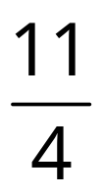
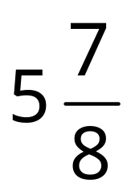
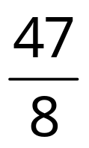
Mixed Numbers To Improper Fractions
3½
2¾

Slide 3





Improper Fractions to Mixed Numbers
¼
¼
¼
¼
¼
¼
¼
¼
¼
¼
¼
¼
¼
¼
¼
¼
¼
2¾
¼
¼
¼
¼
¼
1
2

Slide 4
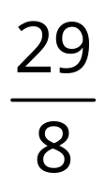





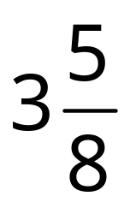

Improper Fractions to Mixed Numbers
1
2
3

